Slide 1
An Introduction To
Numerical Methods and Analysis

Slide 2
Solution of Nonlinear Equations

Slide 3
Introduction

Slide 4
In this chapter we study one of the fundamental problems of numerical analysis, namely the numerical solution of nonlinear equations.
Most equations arising in practice are nonlinear and are rarely of a form which allows the roots to be determined exactly.

Slide 5
Consequently, numerical methods are used to solve nonlinear algebraic equations when the equations prove intractable to ordinary mathematical techniques.
These numerical methods are all iterative, and they may be used for equations that contain one or several variables.

Slide 6
Important Points

Slide 7
I. A nonlinear equation in this chapter may be considered any one of the following types:
1. An equation may be an algebraic equation (a polynomial equation of degree n) expressible in
the form:
where are constants. For example, the following equations are nonlinear.

Slide 8

2. The power of the unknown variable (not a positive integer number) involved in the equation
must be difficult to manipulate.
For example, the following non-polynomial equations are nonlinear

Slide 9

3. An equation may be a transcendental equation, the equation which involves the trigonometric
functions, exponential functions and logarithmic functions.
For example, all the following
transcendental equations are nonlinear

Slide 10
II. Given nonlinear equation must be put in the following form
f(x) = 0,
where f(x) must be nonlinear function.

Slide 11
III. There may be many roots of the given nonlinear equation but we will seek the approximation of only one of its real root α lies in the given interval [a, b], that is
f(α) = 0, where α ∈ [a, b].

Slide 12
IV. If f(x) is continuous function in a interval [a, b] and f(x) has opposite signs at the end
points of the interval, then there must be a root of nonlinear equation f(x) = 0 in [a, b].

Slide 13
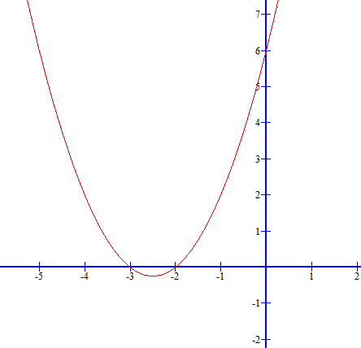


V. Root of a nonlinear equation may be simple
(not repeating) or multiple (repeating).
Simple root means
For example,
are the simple roots of the nonlinear equation

Slide 14

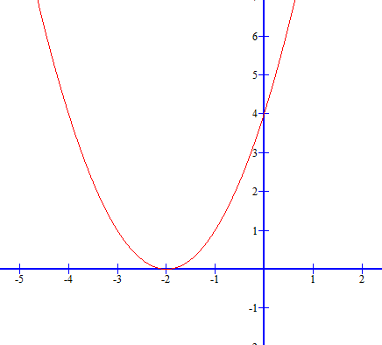

For the multiple root, we mean
For example,
are the multiple roots of the nonlinear equation

Slide 15
VI. The methods we will consider in this chapter are iterative methods and they are,
Bisection method,
fixed-point method,
Newton method (also called, Newton-Raphson method) and
secant method
which give us the approximation of single (or simple) root of the nonlinear equation.

Slide 16
For the multiple roots of the nonlinear equation we will use other iterative methods, called, the first modified Newton’s method (also called the Schroeder’s method) and the second modified Newton’s method. The iterative methods for the approximation of simple root can be use also for the approximation of the multiple roots but they are very slow.

Slide 17
All the numerical methods described in this chapter are applicable to general nonlinear functions.
The iterative methods we will discuss in this chapter are basically of two types:
one in which the convergence is guaranteed
and the other
in which the convergence depends on the initial approximation.

Slide 18
VII. Remember that the best method for the approximation of the simple root of nonlinear equation is Newton’s method (called quadratic convergent method)
and for multiple root of nonlinear equation is modified Newton’s method (called quadratic convergent method).
Newton’s method for multiple root of nonlinear root is called a linear convergent method.

Slide 19
Definition (Root of an Nonlinear Equation)
Assume that f(x) is a continuous function.
A number α for which f(α) = 0 is called a root of the
equation f(x) = 0
or a zero of the function f(x).

Slide 20
First, we shall discuss the numerical iterative methods for simple root of nonlinear equations in a
single variable.
The problem here can be simply written down as:
f(x) = 0.

Slide 21
Method of Bisection

Slide 22
This is one of the simplest iterative technique for determining roots of f(x) = 0 and it needs two initial approximations to start.
It is based on the Intermediate Value Theorem.

Slide 23
This method is also called the interval-halving method because the strategy is to bisect or halve the interval from one endpoint of the interval to the other endpoint and then retain the half interval whose end still bracket the root.

Slide 24
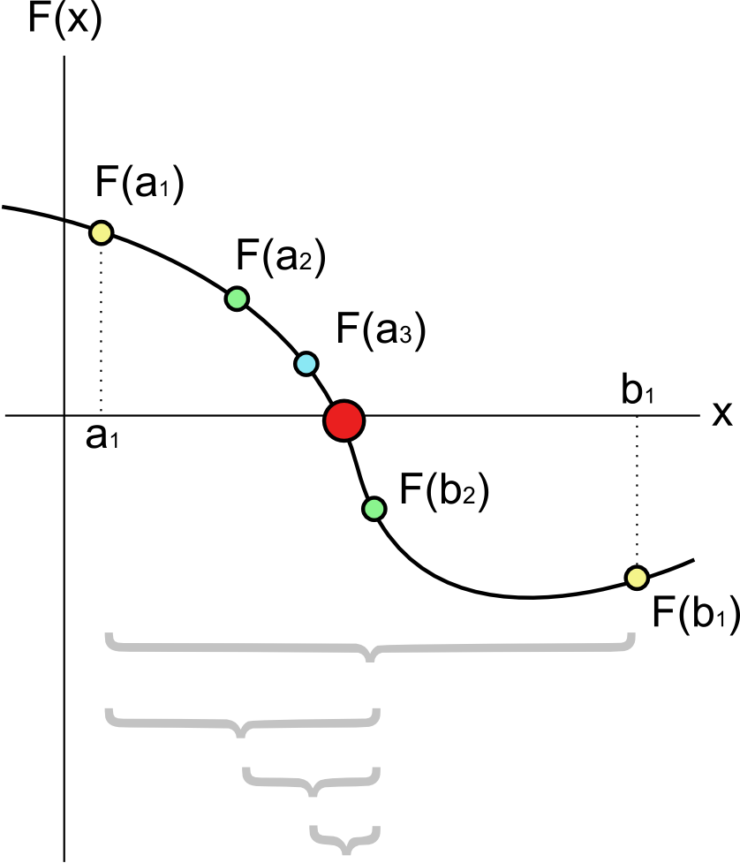

Slide 25
It is also referred to a bracketing method or sometimes called the Bolzano’s method.
The fact that the function is required to change sign only once gives us a way to determine which half interval to retain; we keep the half on which f(x) changes sign or became zero.

Slide 26
The basis for this method can be easily illustrated by considering a function y = f(x).
Our object is to find an x value for which y is zero.

Slide 27
Using this method, we begin by supposing f(x) is a continuous function defined on the interval [a, b] and then by evaluation the function at two x values, say, a and b, such that
f(a)f(b) < 0.

Slide 28
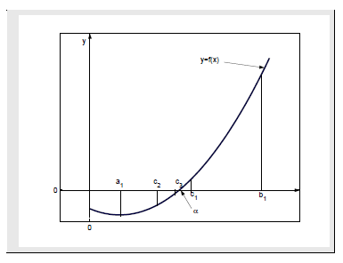
The implication is that one of the values is negative and the other is positive.
These conditions can be easily satisfied by sketching the function,

Slide 29
the function is negative at one endpoint a of the interval and positive at other endpoint b and is continuous on a ≤ x ≤b.
Therefore the root must lies between a and b (by Intermediate Value Theorem) and a new
approximation to the root α be calculated as

Slide 30
()
The iterative formula () is known as the bisection method.

Slide 31
If f(c) ≈ 0, then c ≈ α is the desired root, and, if not, then there are two possibilities.
Firstly, if f(a) . f(c) < 0, then f(x) has a zero between point a and point c.
The process can then be repeated on the new interval [a, c].

Slide 32
Secondly, if f(a) . f(c) > 0
it follows that f(b) . f(c) < 0
since it is known that f(b) and f(c) have opposite signs.
Hence, f(x) has zero between point c and point b and the process can be repeated with [c, b].

Slide 33
We see that after one step of the process, we have found either a zero or a new bracketing interval which is precisely half the length of the original one.
The process continue until the desired accuracy is achieved.
We use the bisection process in the following example.

Slide 34
لتحميل Turbo C++
http://www.4shared.com/rar/uBzQ2hqoce/Borland_Turbo_C_45.html?
لتحميل برنامج Program Code
http://faculty.ksu.edu.sa/dr.abhari/DocLib1/%D8%B1%D9%8A%D8%B6%20254%20%D8%A7%D9%84%D8%B7%D8%B1%D8%A7%D8%A6%D9%82%20%D8%A7%D9%84%D8%B9%D8%AF%D8%AF%D9%8A%D8%A9/%D8%A7%D9%84%D9%88%D8%AD%D8%AF%D8%A9%20%D8%A7%D9%84%D8%A3%D9%88%D9%84%D9%89/bisectio.cpp
لتحميل برنامج رسم الدوال
http://www.4shared.com/rar/r6farDfLce/SetupGraph-442.html

Slide 35
Example 1

Slide 36




Example
Use the bisection method to find the approximation to the root of the equation
that is located in the interval accurate to
Within

Slide 37
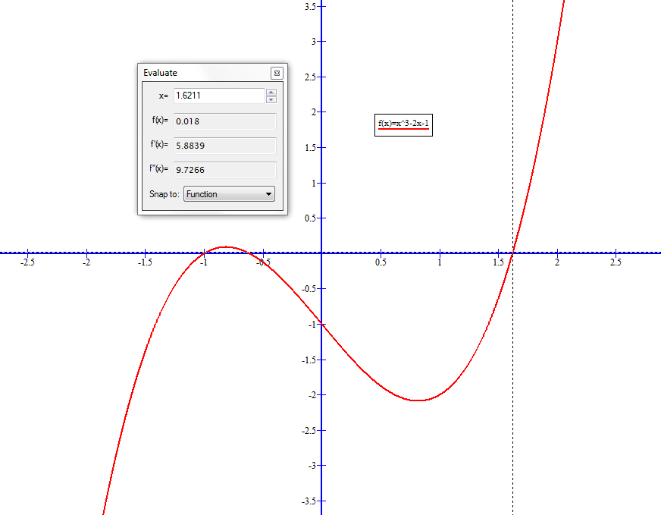
لتحميل برنامج رسم الدوال
http://www.4shared.com/rar/r6farDfLce/SetupGraph-442.html

Slide 38
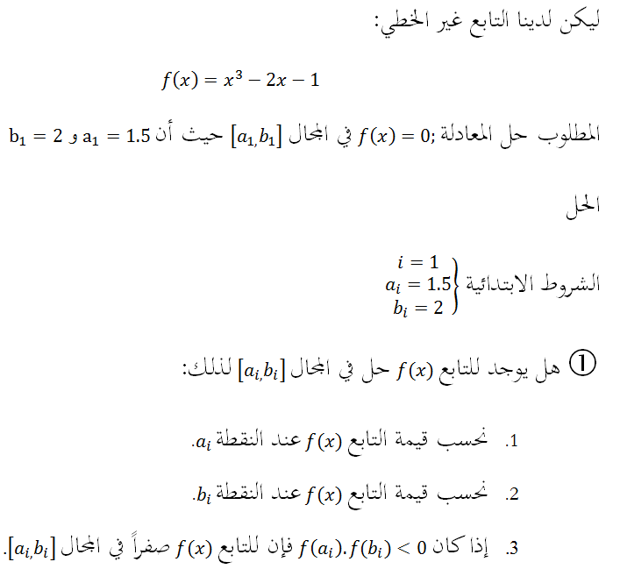

Slide 39
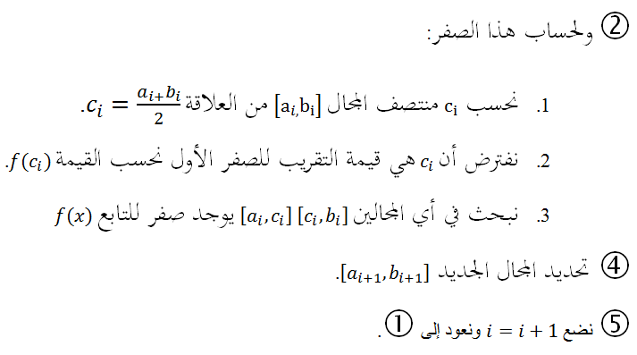

Slide 40
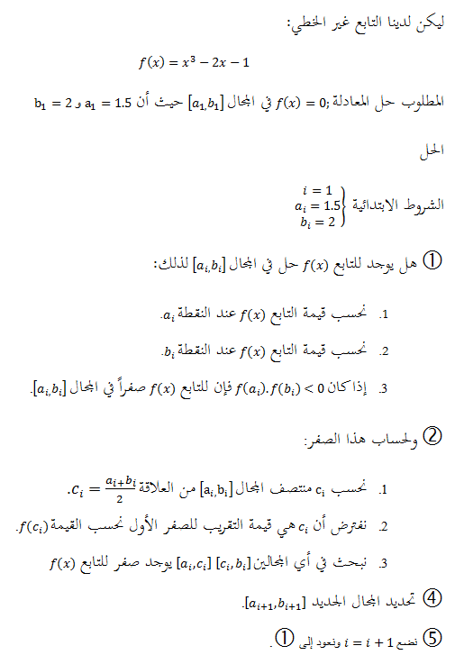

Slide 41
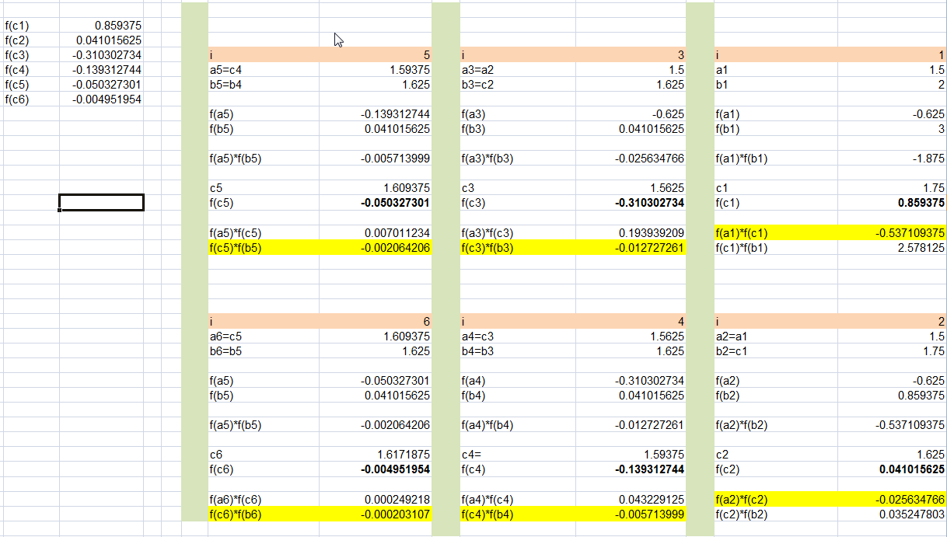

Slide 42
#include<stdio.h>
#include<math.h>
float a,b,c;
int i;
float f(float x)
{
float y;
y=pow(x,3)-2*x-1;
return y;
}
main()
{
i=1;
a=1.5;
b=2;
for(i=1;i<=6;i++)
{
c=(a+b)/2;
printf("%.6f\t",c);
printf("%.7f\n",f(c));
if(f(a)*f(c)<0)
b=c;
else
a=c;
}
return 0;
}

Slide 43
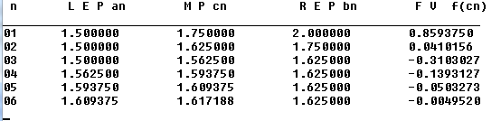

Slide 44
Example 2

Slide 45
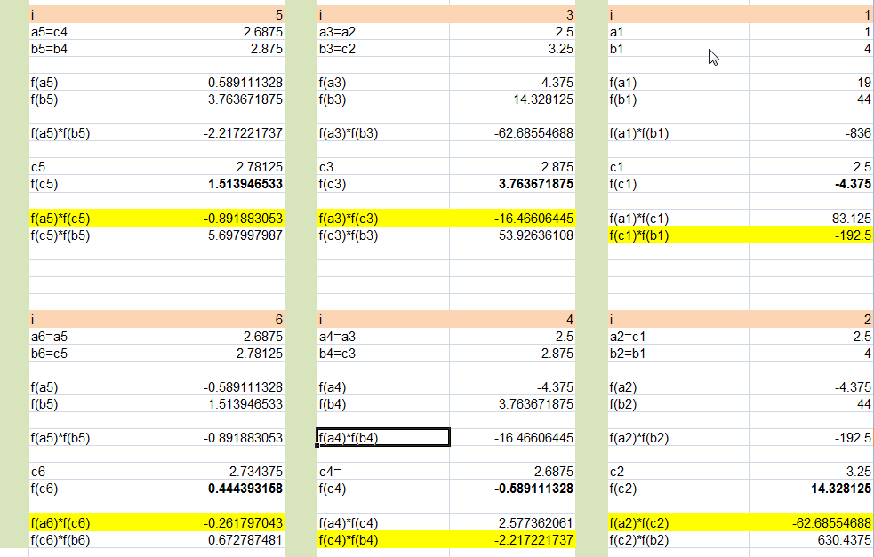

Slide 46
Example 3

Slide 47
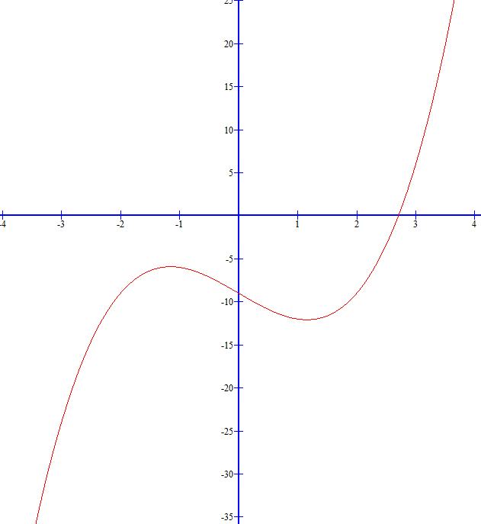

Slide 48
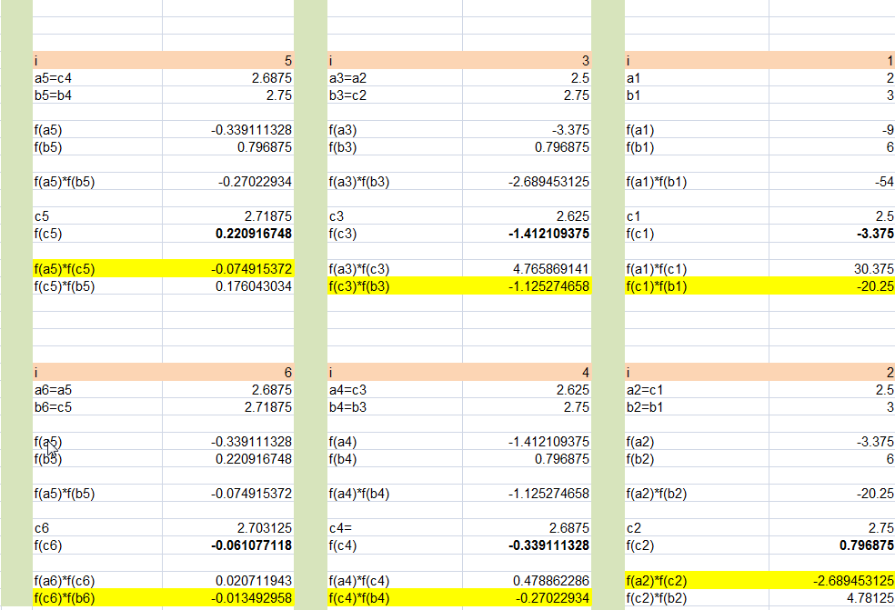


Slide 49
